Slide 1

PIMP Architecture Overview
Platform Intelligence & Modernization Program

Slide 2


Why This Architecture Matters
Cloud onboarding takes 6–9 months due to manual processes, fragmented validation, and late-stage blockers.
PIMP introduces a structured, phased AI architecture to modernize IaC and deployment workflows.
Goal: predictable, scalable, intelligent onboarding—across cloud and on-prem.
Three-Layer Architecture Overview
Each PIMP capability is built on these three cooperating layers.
Autonomous Agent Layer
Platform Intelligence Layer
(Act)
Generative Foundation
(Understand)
(Create)

Slide 3

Layer 1 — Generative Foundation (Create)
Outputs:
Refactored Terraform modules
Standardized IaC
Purpose: automate and standardize all platform artifacts.
Auto-generated documentation
Test plan generation
Migration blueprint creation
Pattern & capability extraction
What the Generative Layer Enables
Eliminates repetitive human work
Produces consistent Terraform and documentation
Accelerates onboarding preparation
Feeds normalized inputs into the intelligence layer

Slide 4

Layer 2 — Platform Intelligence Layer (Understand)
Purpose: give the platform "memory."
Indexed in the Knowledge Graph / RAG:
Terraform modules + versions
Known blockers & incident history
STIG mappings
Service catalogs
Platform capabilities & constraints
Governance & audit rules
Networking rules

Slide 5
What the Intelligence Layer Enables
Proactive Compatibility and Dependency Validation
The Intelligence Layer continuously monitors proposed changes against the established Knowledge Graph, verifying compatibility with existing infrastructure, deployed services, and platform policies. This real-time analysis identifies potential conflicts, version mismatches, and unmet dependencies before deployment, preventing costly errors and ensuring a stable environment.
Automated Risk Scoring and Automation Gap Identification
By indexing known blockers, incident history, and standard operating procedures, the Intelligence Layer can automatically score the risk associated with changes or deployments. It actively identifies areas where automation is missing or incomplete, suggesting new automation workflows or flagging manual steps that introduce potential human error or compliance risks, enhancing overall system reliability and efficiency.
Intelligent Placement and Resource Guidance
Leveraging detailed service catalogs and networking rules, the platform offers precise guidance on where applications and services should be deployed. This includes recommendations for optimal cloud regions, Kubernetes clusters, or specific environments, considering factors like cost, performance, data locality, regulatory requirements, and existing network topologies to maximize efficiency and minimize latency.
Context-Aware and Continuous Learning Recommendations
Based on the current context—user role, project, environment type, and historical deployment data—the Intelligence Layer provides tailored recommendations for resource sizing, security configurations, and architectural patterns. Through continuous learning from successful deployments and operational metrics, these recommendations evolve to become more accurate and effective, guiding users towards best practices and optimal outcomes.
Embedded Governance and Policy Enforcement
The system embeds governance and audit rules directly into the development and deployment pipelines, allowing for proactive policy enforcement without imposing additional friction on developers. It ensures that all activities adhere to security standards, compliance regulations, and internal guidelines by providing guardrails rather than roadblocks, making compliance an inherent part of the process rather than an afterthought.

Slide 6
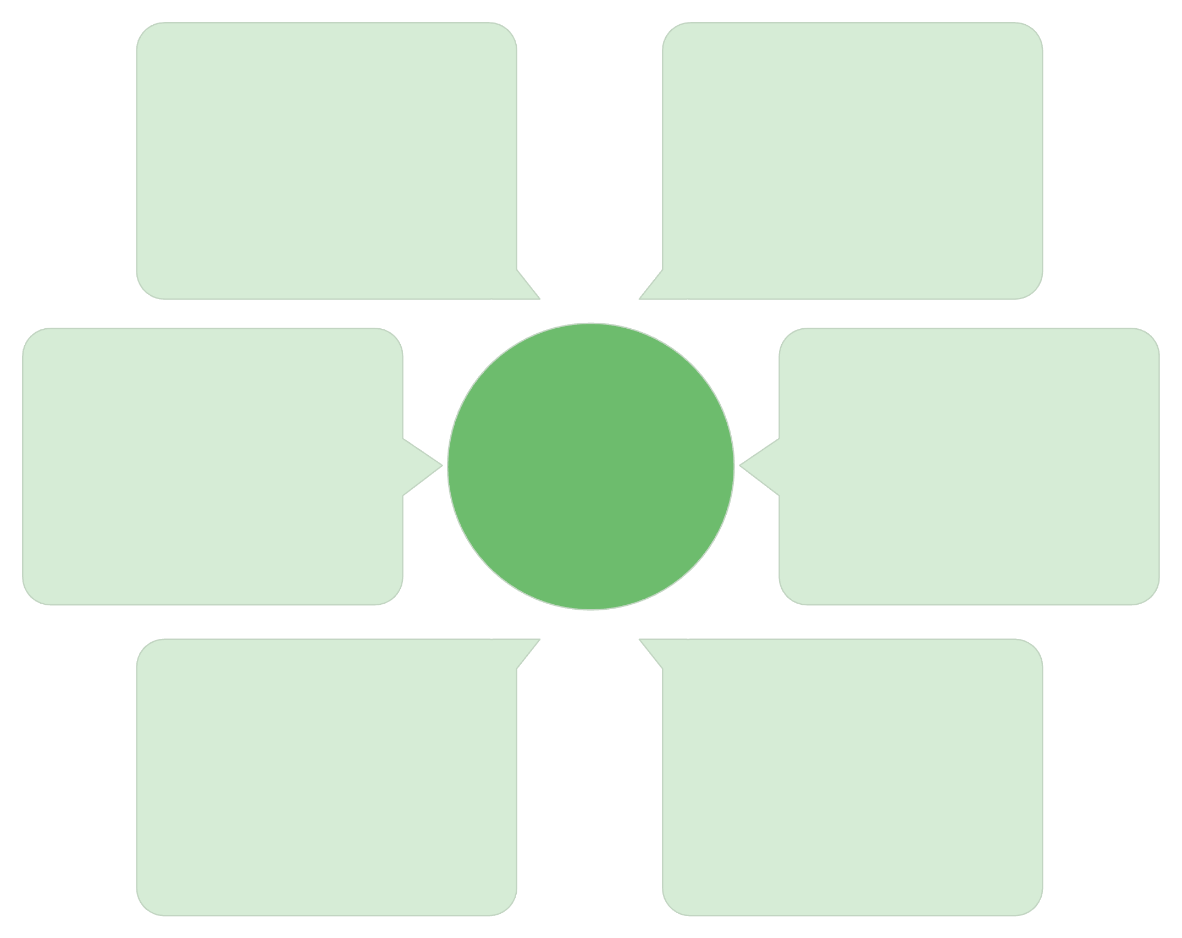
Layer 3 — Autonomous Agent Layer (Act)
Purpose: automate validation and decision-making.
Agents combine generative outputs + the intelligence layer + sandboxed Terraform execution.
QA & Validation Agent
Generated Test Plans
Automated checks and tests
From Generative Layer
Terraform Metadata
Refactored IaC
Agents
Modernized Terraform code
Execution and state info
Constraints + STIGs
Knowledge Corpus
Security and compliance rules
Technical & contextual data

Slide 7
QA & Validation Agents (Deep Dive)
Execute generated test plans
Automatically run comprehensive functional, security, performance, and compliance tests based on IaC definitions and requirements.
Run Terraform apply in isolated sandboxes
Safely deploy proposed IaC changes in isolated, ephemeral environments to prevent production impact and ensure predictable validation.
Detect misconfigurations and STIG violations
Proactively identify deviations from best practices, security baselines, and mandatory STIGs using intelligent parsers and rule engines.
Validate inputs, outputs, dependencies
Ensure the integrity and correctness of data flow and inter-resource relationships, including input validation, output verification, and dependency resolution.
Produce audit-ready evidence
Automatically generate comprehensive documentation of validation activities, including execution logs, compliance reports, and configuration snapshots for auditing.
Score designs for risk & completeness
Provide actionable insights by assigning risk, completeness, operational readiness, and cost optimization scores to IaC designs.

Slide 8
The Five PIMP Pillars — Defined
Modernization Hub
Deployment Advisor
Migration Blueprint Generator
Automates the refactoring, standardization, and improvement of existing Terraform modules, patterns, and platform artifacts. Eliminates drift, tribal knowledge, and manual cleanup.
Evaluates application designs and provides guidance on cloud/on-prem placement, service selection, and configuration alignment based on technical requirements, constraints, and cost considerations.
Generates clear, prescriptive migration plans, Terraform layouts, dependency maps, and architectural blueprints to help teams transition from on-prem to cloud or modernized patterns.
Compatibility & Alignment
Autonomous Quality & Assurance
Validates designs against TD platform rules, constraints, STIGs, Terraform coverage, and integration patterns. Identifies missing automation, conflicts, and risks early in the onboarding process.
Agent-driven validation that executes tests, runs sandbox Terraform applies, verifies resources, and produces audit-ready evidence. Ensures modules and designs are correct, safe, and compliant before deployment.

Slide 9

How the Five Pillars Fit Together
These pillars form the consumable capabilities exposed to TD engineering teams.
Generative Foundation
Feeds the Modernization Hub
Platform Intelligence
Drives Deployment, Migration, Compatibility
Autonomous Agent
Enables Quality & Assurance

Slide 10
End-to-End Workflow
Outcome: onboarding shifts from manual interpretation to automated correctness.
01
02
03
App Team -> Generative Layer
Generative Layer -> Intelligence Layer
Intelligence Layer -> Agents
Submit design / inputs
Contextual reasoning (constraints, STIGs, coverage)
Generated artifacts (TF, docs, tests)
04
05
Agents -> App Team
Agents -> Platform Engineering
Validation results: risks, corrections, missing automation
Platform insights: gaps, priorities, module enhancements

Slide 11
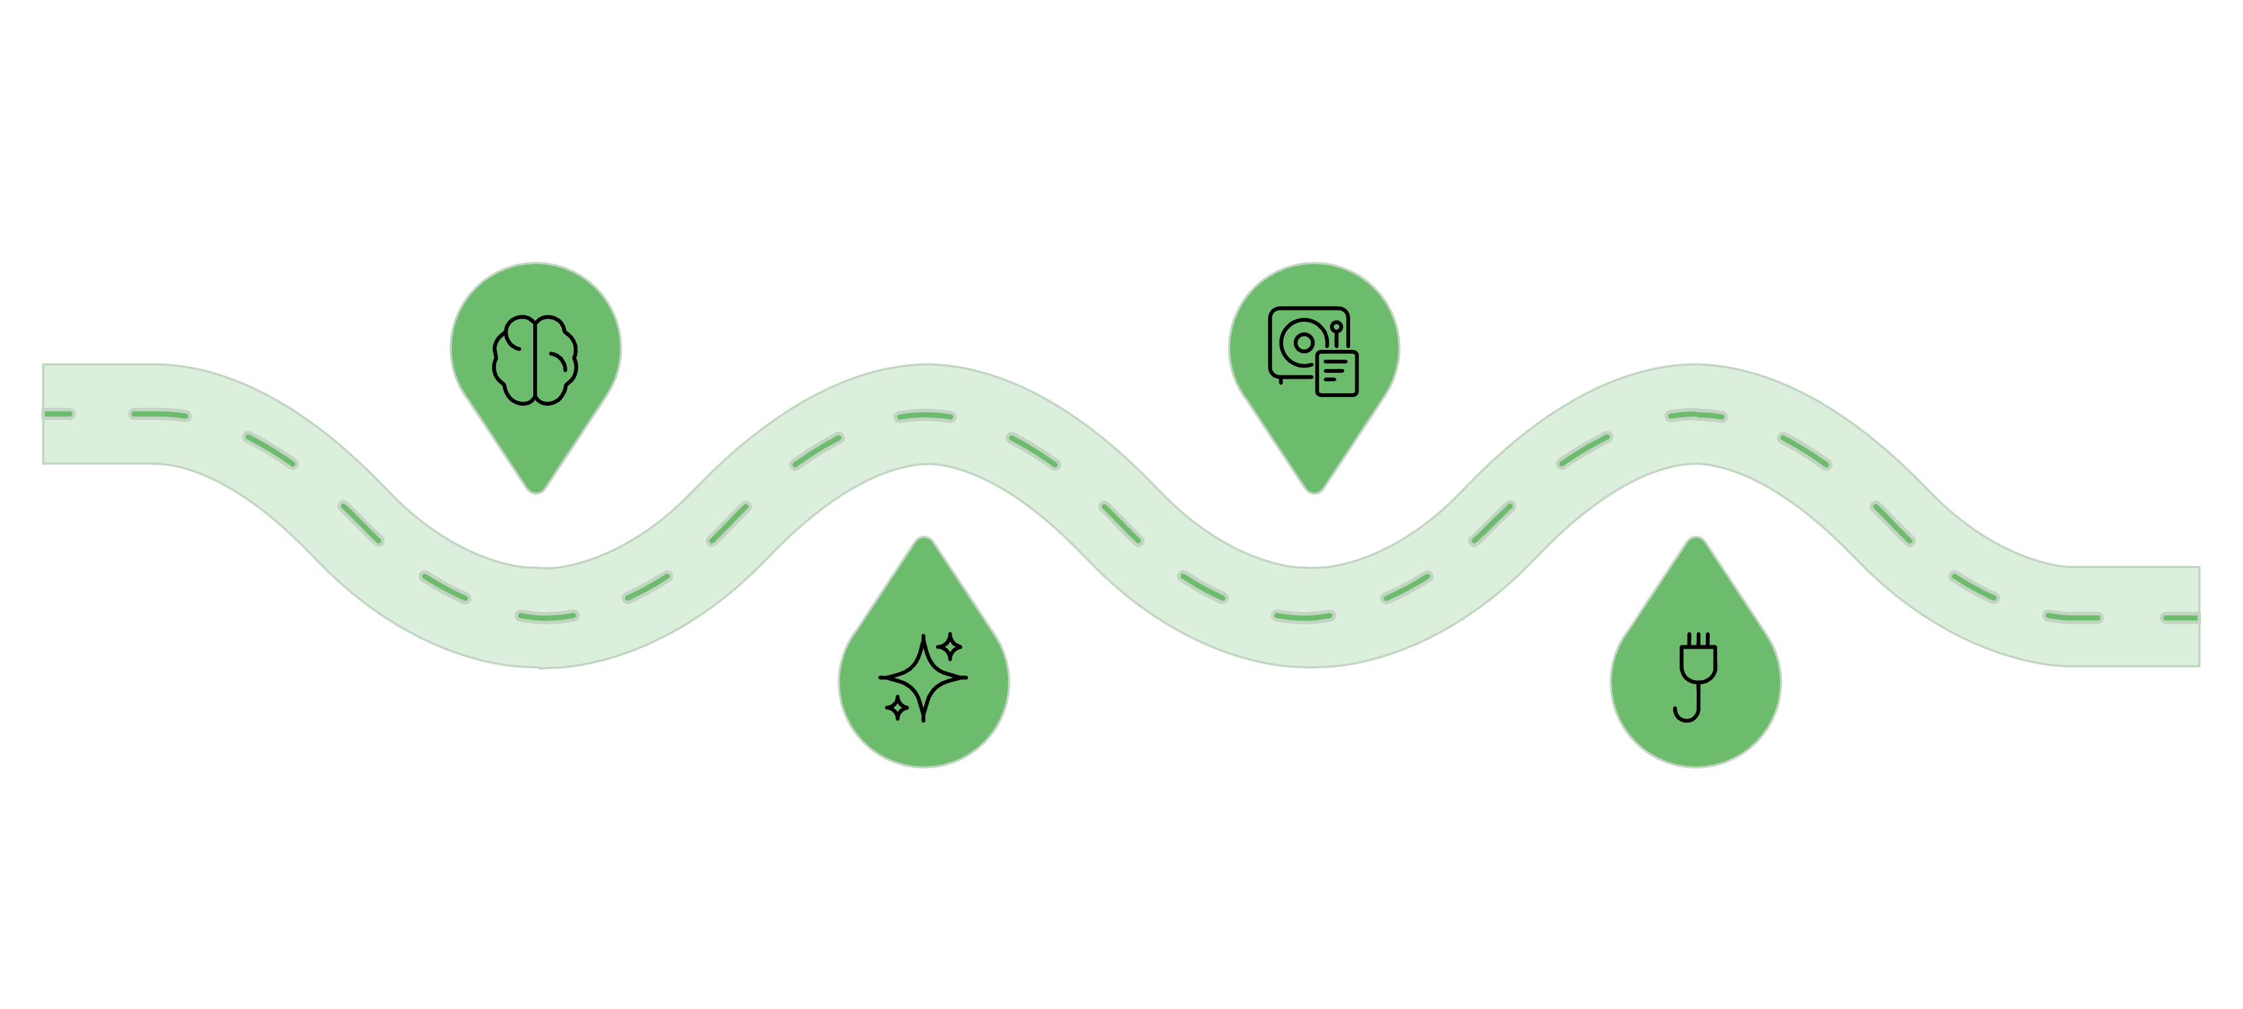
Technical Architecture View (High Level)
Internal LLM
Vector DB / KG
Core private model for reasoning
Store embeddings and relationships
Generative Processing
Agent Orchestrator
Transform prompts into actions
Coordinate agents and workflows

Slide 12
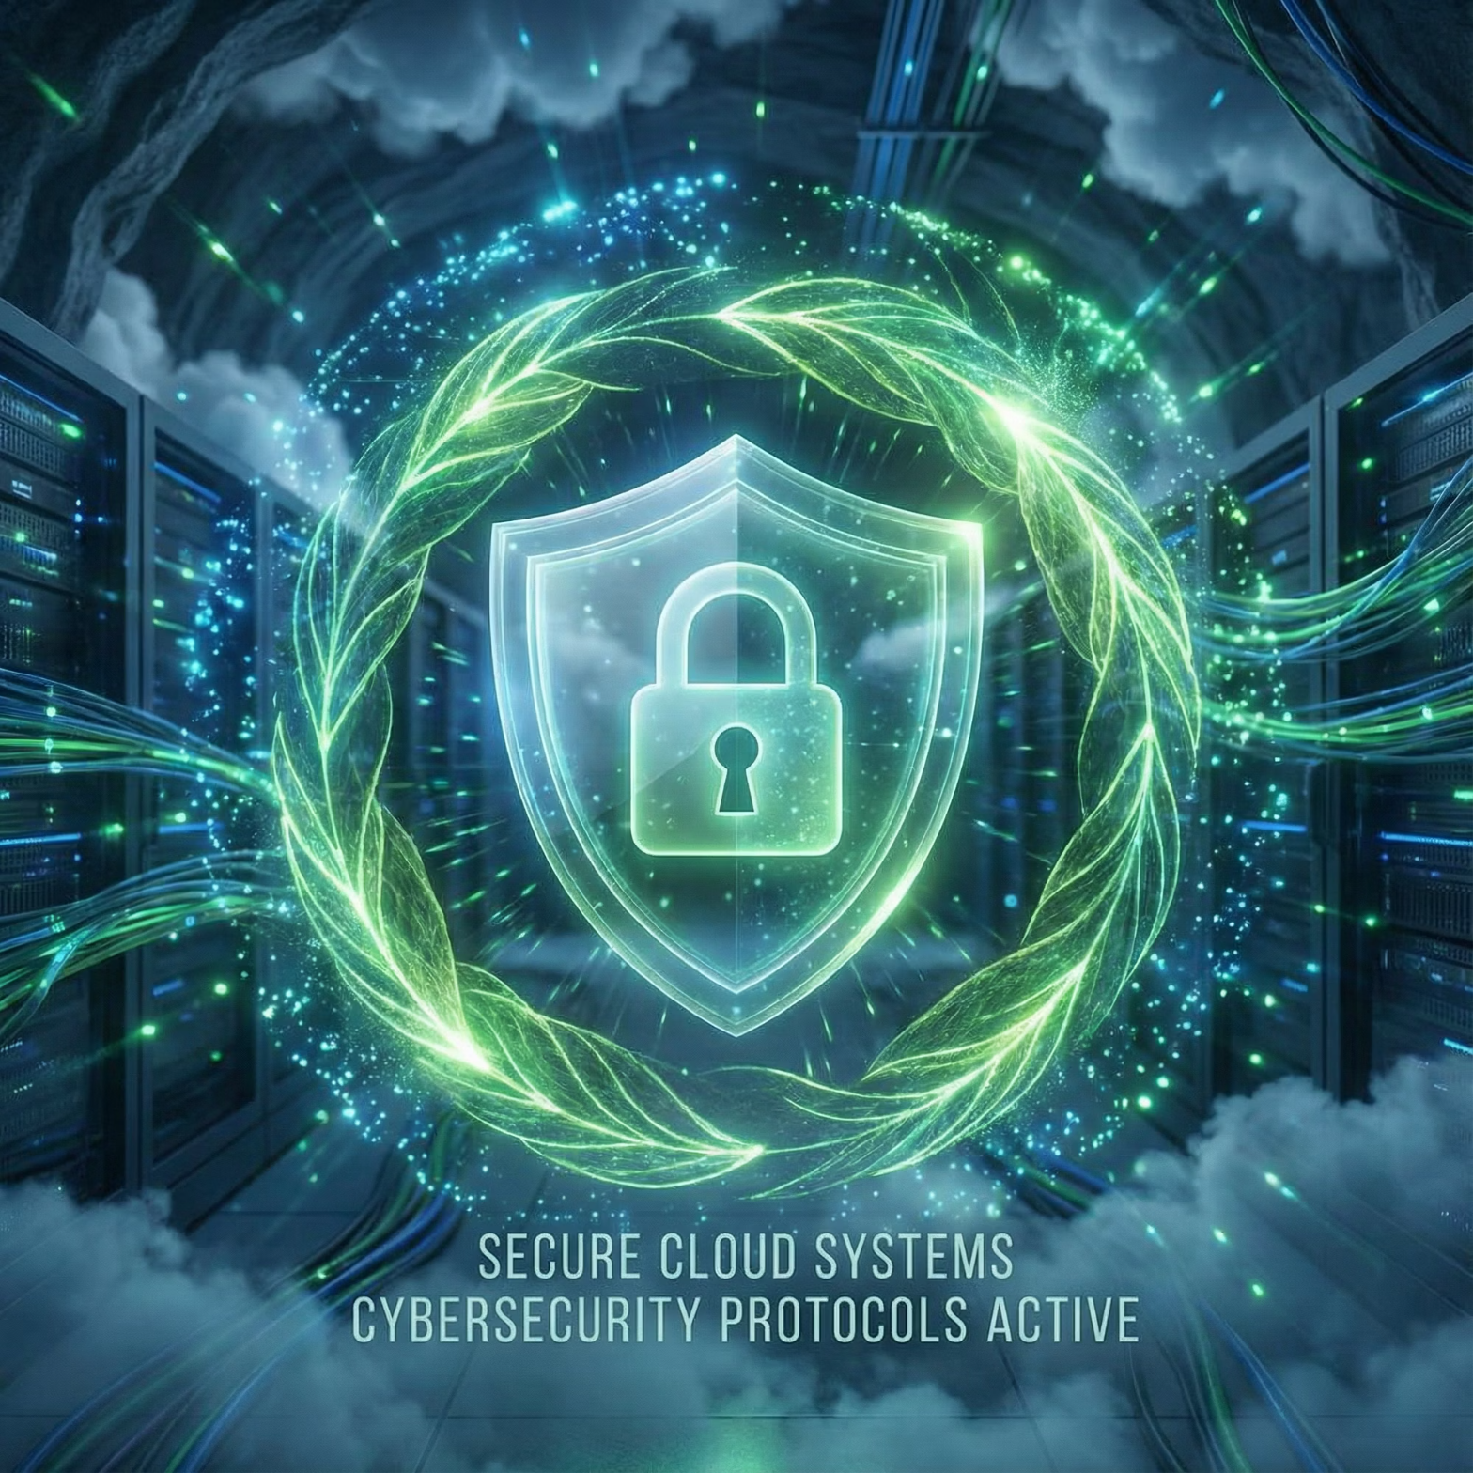
Governance & Safety Model
Agents run in controlled, isolated environments
No autonomous actions against production
All outputs auditable and traceable
STIG and compliance validation built-in
Aligns with TD security engineering standards

Slide 13
Roadmap (Phased Delivery)
Phase 1 — Generate
1
Standardize Terraform, documentation, test plans, blueprints.
2
Phase 2 — Understand
Build the Knowledge Graph / RAG and platform intelligence.
Phase 3 — Act
3
Introduce autonomous agents for QA, validation, and advisories.
4
Phase 4 — Integrate
Embed PIMP capabilities in platform workflows, pipelines, and onboarding.

Slide 14

Summary
PIMP creates a predictable, intelligent, scalable cloud platform for TD
— reducing onboarding timelines, eliminating rework, modernizing Terraform, and enabling data-driven decision-making across engineering.

